Slide 1

Predicting housing prices in Iowa
Guillermo Ruiz
05 March 2021

Slide 2
Motivation
The aim of the project is to find the algorithm that can best predict housingprices in Ames, a city in the State of Iowa, USA.
This algorithm is meant to help real estate companies to:
Better price their housing assets, providing a benchmark that encapsulates the information in the market.
Provide insigh on the type of housing (relevant features) that will be more profitable to build in future real estate development in the area.
3
Machine learning models
Multiple linear regression
Lasso regression
Ridge regression
Gradient boosting
Random forest
Planned steps
2
Data preprocessing
Missing values
Feature engineering
Outliers
Normalization
Dummification
Target variable’s transformation
1
Data
How is our data?
Motivation
Data
Preprocessing
Models
Conclusions

Slide 3
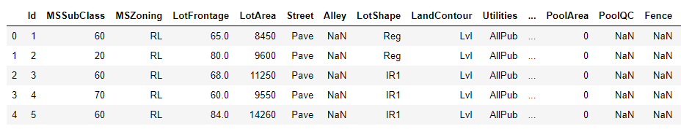
Data
1. House prices - advanced regression tecniques (Kaggle)
2. 1460 observations
3. 81 variables
Motivation
Data
Preprocessing
Models
Conclusions

Slide 4
Split dataframe
Right at the start the dataframe is split into training and testing sets. Every step in the project will be applied separately to each of them.
Training set
80% of observations
1
y_train: vector with housing prices (target variable).
x_train: dataframe with explanatory variables.
2
Testing set
20% of observations
y_test: vector with housing prices (target variable).
x_test: dataframe with explanatory variables.
Motivation
Data
Preprocessing
Models
Conclusions

Slide 5
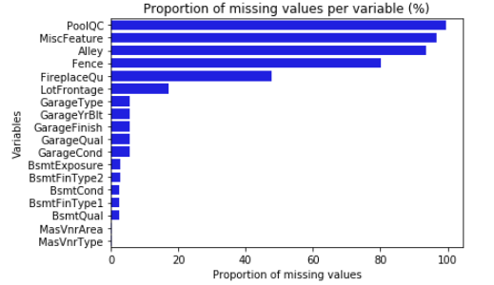
Missing values in the training set
The number of missing values is 5568.
The number of rows with missing values is 1168.
‘None’ imputed
Median imputed
‘None’ imputed
Median imputed
Mode imputed
Motivation
Data
Preprocessing
Models
Conclusions

Slide 6
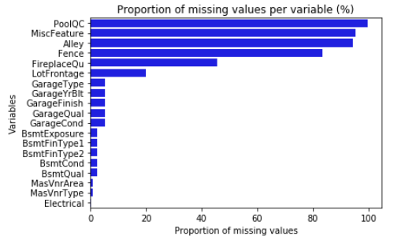
Missing values in the testing set
The number of missing values is 1397.
The number of rows with missing values is 292.
‘None’ imputed
Median imputed
‘None’ imputed
Median imputed
Mode imputed
Motivation
Data
Preprocessing
Models
Conclusions

Slide 7
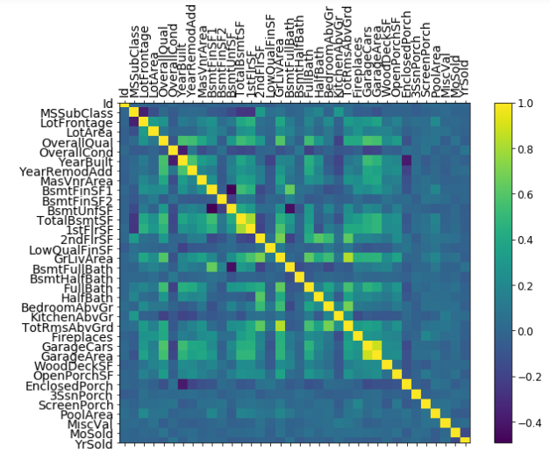
Feature engineering
Motivation
Data
Preprocessing
Models
Conclusions

Slide 8
Feature engineering
This feature is just an index so any correlations with the dependent or any other variables is random.
Id
- haspool: is there a pool.
- hasgarage: is there a garage
- has2ndfloor: 2nd floor.
- hasbsmt: is there a bsmt.
hasfireplace: is there a
fireplace.
This new feature is created by adding up other variables that add up to the total square footage of each house/observation.
Dummies
TotalSF
Features
This variable takes the number of years since the house was built or remodeled.
This new feature includes the number of bathrooms in the house/observation.
YrBltAndRemod
Total_Bathrooms
Total_porch_sf
New feature that includes the total square footage of the porch in each house/observation.
Motivation
Data
Preprocessing
Models
Conclusions

Slide 9
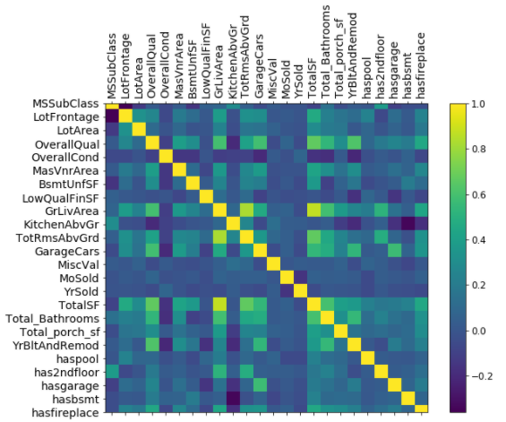
Feature engineering
Motivation
Data
Preprocessing
Models
Conclusions

Slide 10
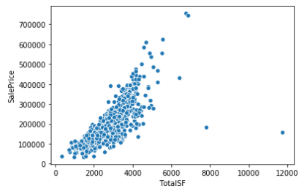
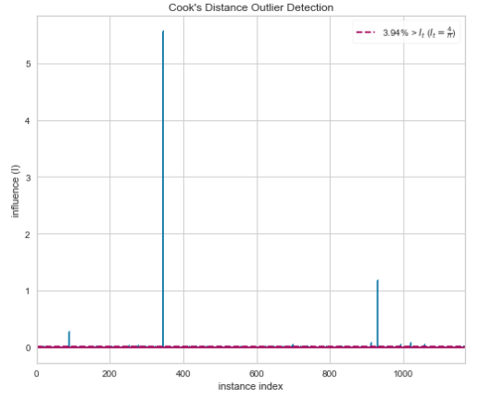
Outliers
1
2
3
Check observations that fall out of the inter quantile range (IQR). Appended to list.
Cook´s distance is implemented. Highlighted observations are appended to another list.
Drop the outliers that appear in both lists.
Three observations fulfill both conditions and are dropped.
Motivation
Data
Preprocessing
Models
Conclusions

Slide 11
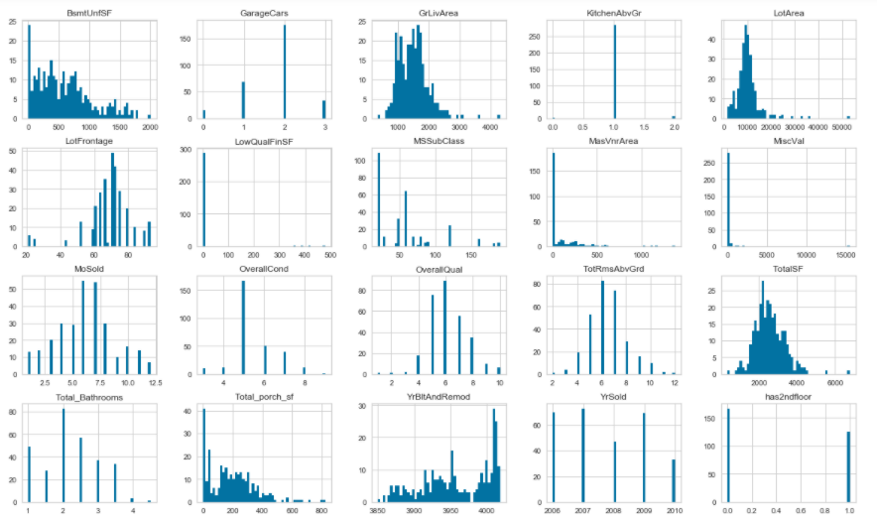
Yeo – Johnson transformation
Motivation
Data
Preprocessing
Models
Conclusions

Slide 12
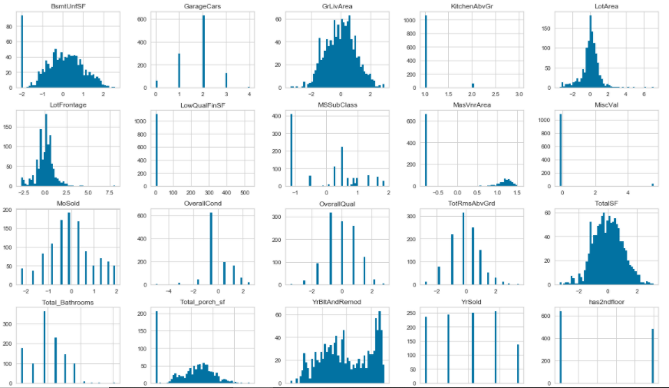
Yeo – Johnson transformation
Motivation
Data
Preprocessing
Models
Conclusions

Slide 13
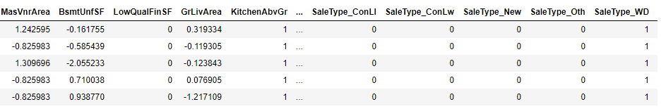
Dummification
The categorical variables in the dataframes containing the explanatory features are dummified .
Motivation
Data
Preprocessing
Models
Conclusions

Slide 14
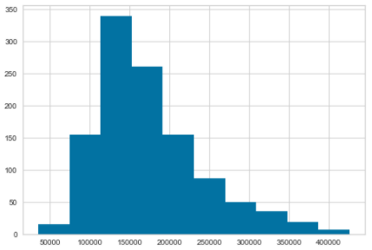
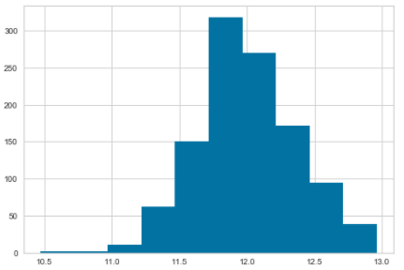
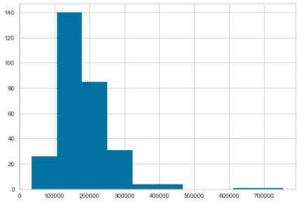
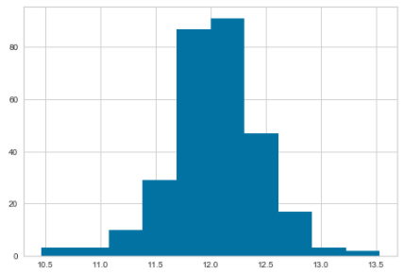
Logarithmic transformation
Training set
Testing set
Motivation
Data
Preprocessing
Models
Conclusions

Slide 15
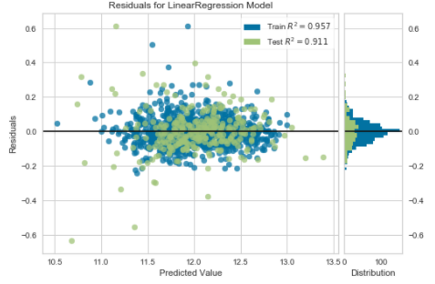
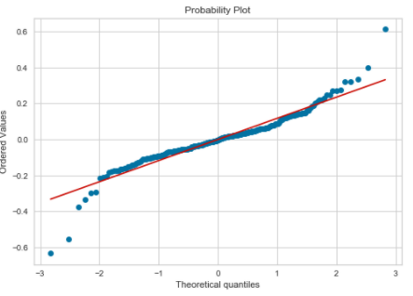
Linear Regression Model
1
2
Training set R-squared = 0.9569659155802756
Testing set R-squared = 0.9112498198756301
Assumptions
Durbin-Watson test (statistic = 1.899)
Multicollinearity
Motivation
Data
Preprocessing
Models
Conclusions

Slide 16
Linear Regression Model
1
2
Training set R-squared = 0.9569659155802756
Testing set R-squared = 0.9112498198756301
Mean squared error (MSE) = 0.014937903504280614
Mean absolute error (MAE) = 0.08406084156396074
Root mean squared error (RMSE) = 0.12222071634661864
Assumptions
Durbin-Watson test (statistic = 1.899)
Multicollinearity
Motivation
Data
Preprocessing
Models
Conclusions

Slide 17
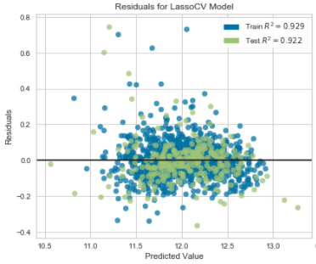
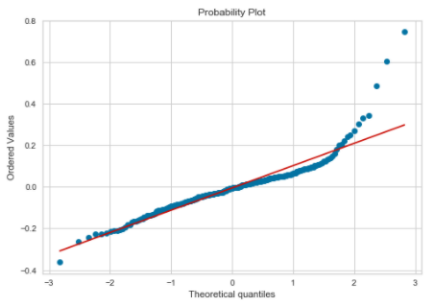
Lasso Regression Model
1
2
Training set R-squared = 0.9294692043037703
Testing set R-squared = 0.921962787855616
Assumptions
Durbin-Watson test (statistic = 1.924)
Motivation
Data
Preprocessing
Models
Conclusions

Slide 18
Lasso Regression Model
1
2
Training set R-squared = 0.9294692043037703
Testing set R-squared = 0.921962787855616
Mean squared error (MSE) = 0.01313476032524457
Mean absolute error (MAE) = 0.07634561732058454
Root mean squared error (RMSE) = 0.11460698200914536
Assumptions
Durbin-Watson test (statistic = 1.899)
Multicollinearity
Motivation
Data
Preprocessing
Models
Conclusions

Slide 19
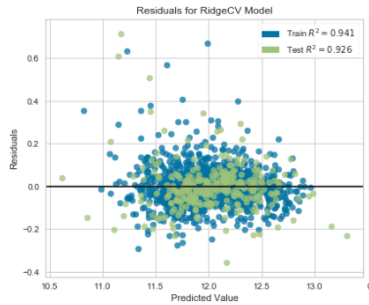
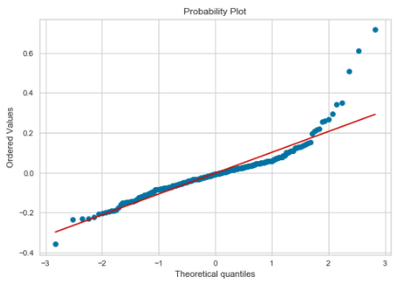
Ridge Regression Model
1
2
Training set R-squared = 0.9407457919892735
Testing set R-squared = 0.9256037842621195
Assumptions
Durbin-Watson test (statistic = 1.883)
Motivation
Data
Preprocessing
Models
Conclusions

Slide 20
Ridge Regression Model
1
2
Training set R-squared = 0.9407457919892735
Testing set R-squared = 0.9256037842621195
Mean squared error (MSE) = 0.01252192942277695
Mean absolute error (MAE) = 0.07323091734458329
Root mean squared error (RMSE) = 0.11190142725978498
Assumptions
Durbin-Watson test (statistic = 1.899)
Multicollinearity
Motivation
Data
Preprocessing
Models
Conclusions

Slide 21
Gradient boosting
1
2
Training set R-squared = 0.9333712705524264
Testing set R-squared = 0.8865640970192029
Mean squared error (MSE) = 0.019092857842919406
Mean absolute error (MAE) = 0.08601106976940891
Root mean squared error (RMSE) = 0.138176907777383
Motivation
Data
Preprocessing
Models
Conclusions

Slide 22
Random forest
1
2
Training set R-squared = 0.9828196251779272
Testing set R-squared = 0.8679678190497393
Mean squared error (MSE) = 0.02151
Mean absolute error (MAE) = 0.09125
Root mean squared error (RMSE) = 0.14666
Motivation
Data
Preprocessing
Models
Conclusions

Slide 23
Conclusions
The linear regression models prove better after data preprocessing.
Among them, the ridge regression is the best performing model.
Models
The algorithm can be used for pricing purposes. The features of real estate assets can be introduced in the model and the algorithm will predict a price for that house.
Pricing
The model´s coefficients provide information about the most valuable features for potential customers. This can provide information for future real estate developments.
Future developments
Motivation
Data
Preprocessing
Models
Conclusions

Slide 24
THANK YOU FOR YOUR ATTENTION
Predicting housing prices in Iowa
Guillermo Ruiz
05 March 2021

